Slide 1

WHEREVER, WHENEVER.
flexit@flexit.fit
www.flexit.fit
Spring 2018
Confidential & Proprietary
Notes:
FONTING: we’re using nexa bold here, but glacial indifference elsewhere. Thoughts?
1AA6C9
A5A5A6

Slide 2

OPPORTUNITY | SOLUTION | BUSINESS
The fitness industry is ripe with opportunity, as the evolving needs of consumers challenge traditional models
$21.8B
Rev/year of the gym and health club industry
57.25M
Members of health clubs in the United States
67%
Of people with gym memberships never use them
$39
Per gym membership is wasted due to underutilization
Source: Statista, The Statistics Portal - 2016
Notes:
Other potential taglines:
The Fitness space is under attack by the needs of the dynamic customer
Trends in the fitness space are disrupting the status quo
The fitness space is facing disruption driven by the
Traditional gym models are under attack by the evolving needs of the customer

Slide 3
OPPORTUNITY | SOLUTION | BUSINESS
Consumers value fitness experiences that offer flexibility
Consumers are…
Conditioned to access fitness a-la-carte and pay only for what they use
Discouraged by memberships that require long-term commitments and are painful to exit
Empowered by variety in options to meet their fitness goals
Enabled by convenience to keep up with their busy lifestyles
Digitally connected and value seamless integration
Motivated by community
Notes:
Cost savings, pay for what you use and do waste money
Lets emphasize the consumer pain point, its not as clear as it should be
Punch up importance of value and transparency

Slide 4
OPPORTUNITY | SOLUTION | BUSINESS
Gyms face significant challenges in meeting their customers’ needs while navigating an increasingly competitive landscape
Gyms face…
High costs to launch and operate facilities, making it difficult to attract and retain profitable customers
Adversity to long term-commitment requiring alternative revenue streams
Proliferation of facilities, including boutique studios, that have stolen market-share
Transient customer-bases that require broad-reach to capture the available market
Demanding customers that desire personalization that is too costly to provide at scale
Tech-savvy customers that expect a digitally connected experience
Notes:
Cost savings, pay for what you use and do waste money
Lets emphasize the consumer pain point, its not as clear as it should be
Punch up importance of value and transparency

Slide 5
OPPORTUNITY | SOLUTION | BUSINESS
The industry is taking notice
… People, especially millennials, are searching for personalized experiences everywhere they go, and that includes looking for unique fitness and workout experiences with a small group of people they connect with on a personal level. Even if they’re traveling or away from home, they expect to be able to keep that routine by walking into a local boutique gym on a per-session basis or by using a digital fitness app outside, in a hotel – or almost anywhere for that matter ”
Adam Zeitsiff, CIO - Gold’s Gym International
January 2018
Notes:
As of 2017, anywhere from 5 percent to 26 percent of fitness operators, based on their business model, indicated they engaged with digital aggregators.
“Imagine a set of tablets when you arrive, and other self-service options to streamline a large group of individuals arriving at once, with helpful service professionals available as needed,” says Sarah Abdallah, an interior architect and designer, whose been tasked with incorporating wellness elements for clients like the Ritz-Carlton and Neuehouse, a private club and co-working space. Translation: a less frantic clamoring of leggings-clad folks scrambling to make it in time for the warm-up. “Technology can be integral in helping people make the transition from the chaotic outside world to going within,” -- “Well and Good”

Slide 6
OPPORTUNITY | SOLUTION | BUSINESS
What if…
there were a solution that offered consumers the flexibility they expect while enabling facilities to deliver profitably?
Notes:
Other potential taglines:
The Fitness space is under attack by the needs of the dynamic customer
Trends in the fitness space are disrupting the status quo
The fitness space is facing disruption driven by the
Traditional gym models are under attack by the evolving needs of the customer
Align text

Slide 7
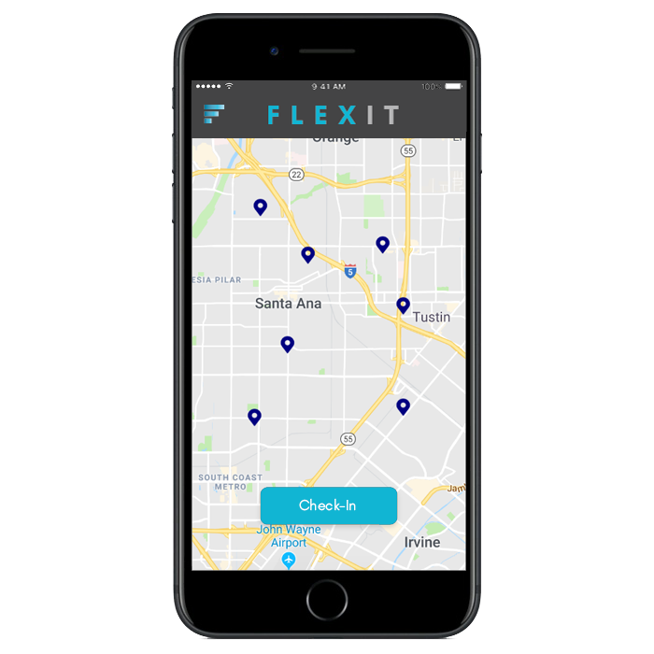
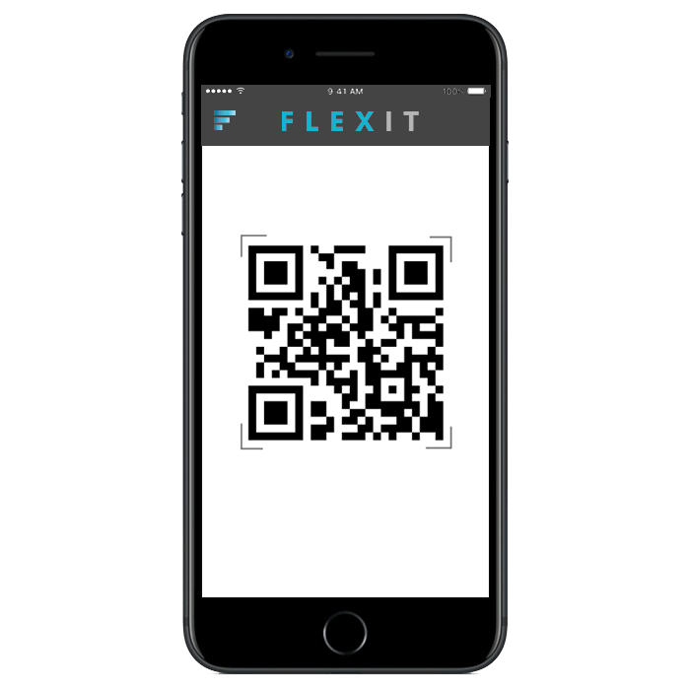
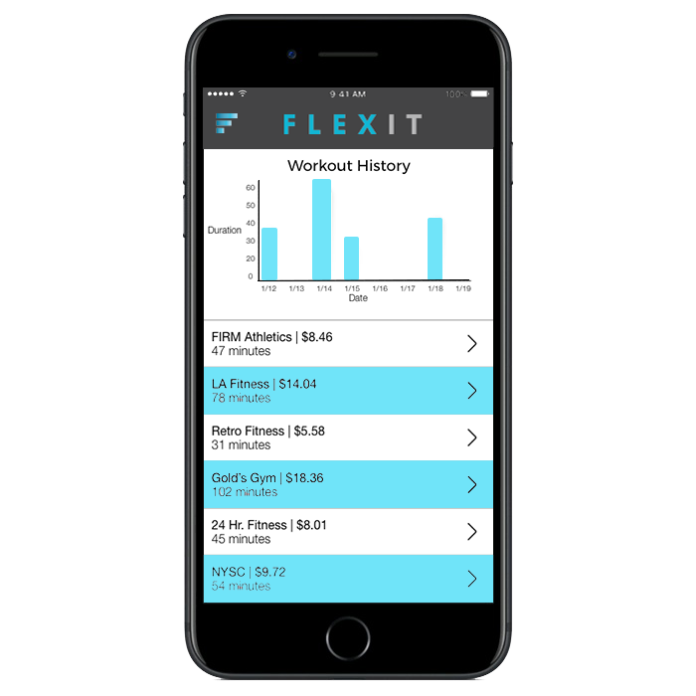
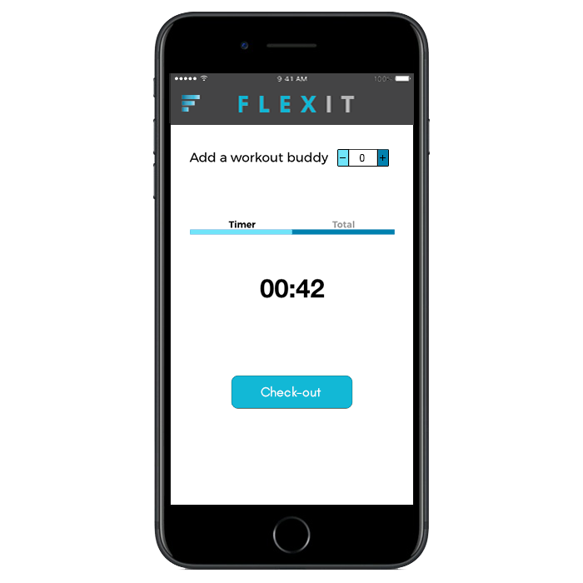
The FlexIt Customer Solution
An a-la-carte, non-membership solution to access health & fitness clubs wherever, whenever
Discover
Check-in
OPPORTUNITY | SOLUTION | BUSINESS
gyms in your community
with a quick and easy scan
THE A-LA-CARTE FITNESS SOLUTION THAT ALLOWS USERS TO WORK-OUT
WHERE THEY WANT, WHEN THEY WANT AND PAY ONLY FOR THE TIME THEY USE
Review
FLEXIT
your activity and progress
using the mobile app
Notes:
Not actual screens, just visual representations.

Slide 8


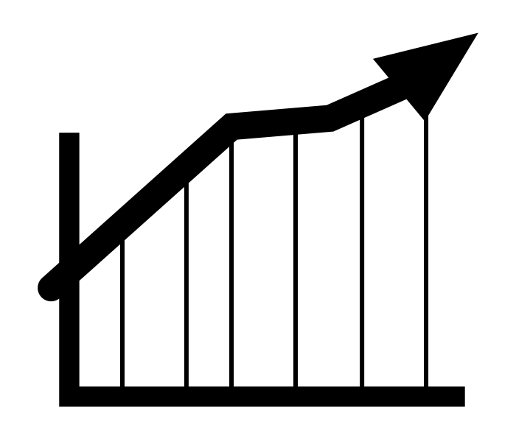






OPPORTUNITY | SOLUTION | BUSINESS
FLEXIT provides solutions to both
Consumers
Gyms
Access to a nation-wide
network of facilities
Increased revenue (via rev share)
Pay only for what
you use
New prospective touchpoints
No long-term
commitments
Membership upticks
Try before you buy
Increased foot traffic
Mobile-based solution that
enables a frictionless experience
Organic cross promotion and marketing
Notes:
Cost savings, pay for what you use and do waste money
Lets emphasize the consumer pain point, its not as clear as it should be
Punch up importance of value and transparency

Slide 9
OPPORTUNITY | SOLUTION | BUSINESS
FLEXIT provides technology to scale for a growing market
200M
40M
2M
Total available market (TAM):
US Population 18-65
Serviceable addressable market (SAM): Adults who work out 2x/week
Serviceable obtainable market (SOM):
Realistic reach
Source: Statista, The Statistics Portal - 2016
Notes:
326 in US
47.8 over 65
Under 18 74M
NEED 326 NUMBER TO NOT INCLUDE ADULTS OVER 65, NOT INCLUDE KIDS UNDER 18
DO CONCENTRIC CIRCLES, NOT THE OVAL
57.3
Need % that go to the gym less than 8x per month
Maybe concentric circles
Market comp, center align
Wrapo more evely

Slide 10
OPPORTUNITY | SOLUTION | BUSINESS
FLEXIT has a multifaceted approach to acquiring and retaining customers
Digital
PR
Cost: $$$
Effectiveness: High
Cost: $$$
Effectiveness: High
Social Media
Search Engine
Influencer
Cost: $
Effectiveness: Medium
Cost: $$
Effectiveness: Medium
Cost: $$
Effectiveness: Medium
Partnerships
Email
Affiliate
Offline
Cost: $$
Effectiveness: Low
Cost: $
Effectiveness: Medium
Cost: $
Effectiveness: Medium
Cost: $
Effectiveness: Low
Notes:
Lets add affiliate programs in here, will be very important! Add to middle tier (rewards etc)
Thinking about eliminating the cost/effectiveness thing?

Slide 11













FLEXIT is more affordable and experiential than its competition
An a-la-carte, non-membership solution to access health & fitness clubs wherever, whenever
OPPORTUNITY | SOLUTION | BUSINESS
FLEXIT is more affordable and experiential than its competition
Flexible
Expensive
Affordable
Inflexible
Notes:
Not actual screens, just visual representations.
Expand it out
ADD SOMETHING BOTTOM LEFT AND BOTTOM RIGHT – RETRO BOTTOM RIGHT? WHAT BOTTOM LEFT?

Slide 12
OPPORTUNITY | SOLUTION | BUSINESS
By the numbers
 | FLEXIT P&L
 | FYE June | FY2019 | FY2020 | FY2021 | FY2022 | FY2023
 | Revenue | $283,686 | $1,451,549 | $5,029,293 | $10,967,885 | $20,778,342
 | Yr/Yr Growth |  | 412% | 246% | 118% | 89%
 | Variable Costs
 | Installation Expenses | 24,000 | 60,000 | 120,000 | 180,000 | 240,000
 | Gym Servicing Expenses | 58,000 | 97,200 | 288,000 | 646,800 | 1,209,600
 | Credit Card Costs | 16,517 | 59,785 | 168,404 | 273,921 | 515,186
 | Total Variable Costs | 98,517 | 216,985 | 576,404 | 1,100,721 | 1,964,786
 | Fixed Costs
 | Marketing | 137,000 | 257,050 | 542,013 | 1,020,413 | 1,830,448
 | Salaries & Benefits | 235,750 | 1,681,300 | 3,149,333 | 4,968,437 | 6,995,059
 | G&A | 69,120 | 164,640 | 398,280 | 976,260 | 2,420,670
 | Total Fixed Costs | 441,870 | 2,102,990 | 4,089,625 | 6,965,110 | 11,246,177
 | EBITDA | -256,701 | -868,426 | 363,264 | 2,902,054 | 7,567,379
 | Margin | -90.5% | -59.8% | 7.2% | 26.5% | 36.4%
 | D&A | 12,707 | 17,036 | 20,975 | 19,344 | 15,755
 | Operating Income | -269,408 | -885,463 | 342,289 | 2,882,710 | 7,551,623
 | Taxes | -56,576 | -185,947 | 71,881 | 605,369 | 1,585,841
 | Net Income | -$212,832 | -$699,515 | $270,408 | $2,277,341 | $5,965,782
FYE JUNE | FY2019 | FY2020 | FY2021 | FY2022 | FY2023
Gyms on FlexIt | 240 | 840 | 2,040 | 3,840 | 6,240
Gyms Signed Up | 220 | 600 | 1,200 | 1,800 | 2,400
FYE JUNE | FY2019 | FY2020 | FY2021 | FY2022 | FY2023
Beginning Active Users | 0 | 5,171 | 12,528 | 21,981 | 32,696
Net New Users | 5,171 | 7,357 | 9,453 | 10,715 | 11,542
Ending Active Users | 5,171 | 12,528 | 21,981 | 32,696 | 44,239
Average Active Users | 3,447 | 8,352 | 14,654 | 21,798 | 29,493
FYE JUNE | FY2019 | FY2020 | FY2021 | FY2022 | FY2023
Entry-Tier | 50% | 40% | 30% | 25% | 20%
Mid-Tier | 25% | 35% | 40% | 40% | 40%
Premium-Tier | 25% | 25% | 30% | 35% | 40%
Notes:
57.3
Need % that go to the gym less than 8x per month
Maybe concentric circles
Market comp, center align
Wrapo more evely

Slide 13
OPPORTUNITY | SOLUTION | BUSINESS
What about the platform’s risks?
Risks
Mitigants
Consumers are saturated by other fitness related services and may be resistant to adopt FLEXIT
Gyms are resistant to adopting FLEXIT because it may cannibalize membership-bases
Gyms are resistant to working with a new player in the space
Low barriers to entry increases competition
Increasingly noisy ecosystem
FLEXIT’s customer acquisition strategy is designed to promote its value proposition using a comprehensive approach
FLEXIT is designed to bring new users and prospective members that will offset losses in membership
FLEXIT’s corporate team has deep industry success, expertise and C-level relationships at the biggest national gym chains in the country
FLEXIT’s competitive advantage is its deep industry relationships, existing soft commitments and industry knowledge
FLEXIT fills a niche segment of the market and an untapped need
Notes:
To consumers → no obvious risk
MAIN RISK : GYM OWNERS LOVE THE GUYS WHO DON’T GO AND PAY AND NEVER GO – CANNIBALIZATION – BE SENSITIVE – “only reason gyms survive is big population who pay high membership rates and don’t use it” and if cannbailized it then would be a big risk
BARRIER TO ENTRY ISNT HIGH : AND CALSSPASS HAS GYM TIME
Omar says takeaway by fitness industry – educated ppl in urban places who are tech forward with more money, and then u have ppl and gym owners etc who is some guy who played baseball I ncollege and is very offline type of person and has paper sign in sheets and is very non digital and technical. From consumer base standpoint omar concern is ppl like us may have classpass
Thinks its one tap on classpass

Slide 14
FLEXIT is seeking funding to support the growth of its business. FLEXIT needs $100K to launch this summer, and an additional $400K for its first 12 months of operations.
OPPORTUNITY | SOLUTION | BUSINESS
Investment Details
Deal Terms
Uses of Capital
 | Raise | Up to $500K SAFE
 | Valuation Cap | $2.5M Cap
 | Discount | 20%
 | Runway | 12 months
 | $72K | Technology | Consumer App Tablet App/Admin Panel
 | $140K | PR/Marketing | Launch/Ongoing PR Targeted Digital Strategy
 | $53K | Working Capital | Hardware purchase Inventory & Storage
 | $235K | Personnel/Ops | CTO; COO; Biz Dev Hardware Training
 | $500K
Notes:
$1M raise, $2M qualifying event, $4.5M cap
20% discount, 6% interest, 2-year maturity
Safe-Note
$1.8M cap
20% discount, 6% interest, 2-year maturity

Slide 15
OPPORTUNITY | SOLUTION | BUSINESS
Mission & Vision
FLEXIT’s mission is to make fitness more accessible. FLEXIT will enable more individuals to workout where they want, when they want. FLEXIT will accrue more minute across its platform than the largest grossing individual gym chain in the country.
Notes:
Revolutionizing the industry
The way people access fitness
ETC ETC.
To invest in flexit v a gym is a way of participating in secular trend without the capital cost.

Slide 16

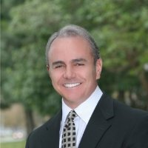
The Team
OPPORTUNITY | SOLUTION | BUSINESS
The Team
CEO – Austin Cohen
TBD – Kevin Batista
Head of Biz Dev – Michael Rojas
Sed ornare at felis vel fdasf fd. Suspendisse suscipit quam
quam facilisis, et facilispulvinar. Donec cursus efficitur mi,
Sed ornare at felis vel fdasf fd. Suspendisse suscipit quam
quam facilisis, et facilispulvinar. Donec cursus efficitur mi,
Sed ornare at felis vel fdasf fd. Suspendisse suscipit quam
quam facilisis, et facilispulvinar. Donec cursus efficitur mi,

Slide 17
WORKOUT WHEREVER, WHENEVER.
Austin Cohen
516.417.2741
austin@flexit.fit
FlexIt,Inc. Is an a-la-carte non-membership solution to access health and fitness clubs wherever, whenever. FlexIt provides on-demand access to gyms so that users can enjoy the privileges of membership without the hassle, and pay solely for the time they use.
This presentation contains forward-looking statements. In some cases, you can identify forward-looking statements by terms such as “may,” “will,” “should,” “could,” “would,” “expects,” “plans,” “anticipates,” “believes,” “estimates,” “projects,” “predicts,” “potential,” and similar expressions. Forward-looking statements involve assumptions, variables, risks, and uncertainties that may cause actual results, performance, or financial conditions to be materially different from the expectations of future results, performance or financial conditions expressed or implied in such forward-looking statements. Such factors include, but are not limited to our ability to raise capital, develop certain technologies and generate sales, and ability to expand and grow our distribution channels, changes in business plans, regulatory changes and political and economic factors. Actual outcomes and results may differ materially from what is expressed or forecasted in such forward-looking statements due to numerous risks and uncertainties. Certain information provided in this presentation comes from publicly available or third-party sources. While FlexIt, Inc. believes such information to be correct, it makes no expressed or implied representation or warranty as to the accuracy or completeness of any such information or any forward-looking statements set forth in this presentation or as to the reasonableness, accuracy, or completeness of the assumptions from which the forward-looking statements are derived. Forward-looking and all other statements made in this presentation speak only as of the date on which they are made. FlexIt, Inc. has no obligation to update or revise any information or any forward-looking statement to reflect any actual results or changes in its expectations or any change in events, conditions or circumstances on which any such statement is based. This presentation does not constitute or form an offer to sell or issue or solicitation of an offer to purchase or subscribe for any securities of FlexIt, Inc. in any jurisdiction, and no part of this presentation shall form the basis of or be relied upon in connection with any such offer or solicitation or any contract or commitment. Specifically this presentation does not constitute a “prospectus” within the meaning of the U.S. Securities Act of 1933, as amended. The contents of this presentation may not be reproduced, redistributed or passed on, directly or indirectly, to any other person or published, in whole or in part, for any purpose. © FlexIt, Inc.

